Slide 1
HOW it Works
GIO EMS Portal
  http://emergency.copernicus.eu/mapping
GIO EMS USER GUIDE
  EMS USER GUIDE
SERVICE REQUEST FORMS:
GIO EMS Rush Mode SRF_08 protected (no password).doc
GIO EMS Non-Rush Mode SRF_05 protected (no password).doc
USER FEEDBACK FORMS:
  GIO EMS Rush Mode AU-FF_02 protected (no password).doc
  GIO EMS Non Rush Mode EndU-FF_03 protected (no password).doc

Slide 2
Portfolio & Product specification
PRODUCT PORTFOLIO
  EMS USER GUIDE\GIO_EMS-Mapping_Product_Portfolio.pdf
  PRINTED MAPS
Area Of Interest definition
Using Google Earth for AOI definition
  BUCHAREST.kml
Map Scale definition
  Scale_maparea_calc_A1.xls

Slide 3
Scenario Exercise
Flash Flood in Romania, 12th Sept 2013

Slide 4
Module 3: Scenario Exercise
Triggering the GIO EMS Service
Scenario Analysis and activation Exercise [1 hour 25 mins]
All the attendees will be provided with printed copy of:
  Disaster Scenario description
  Service Request Form
  User feedback Form
The exercise with the attendees will go through the following steps:
  Scenario Analysis – Need identification
  AOI selection – Area for Overview and Detailed maps identification
  Product selection and technical specification identification
  Access to the service – SRF compilation
  Service Triggering
  User Feed back – UFF compilation

Slide 5
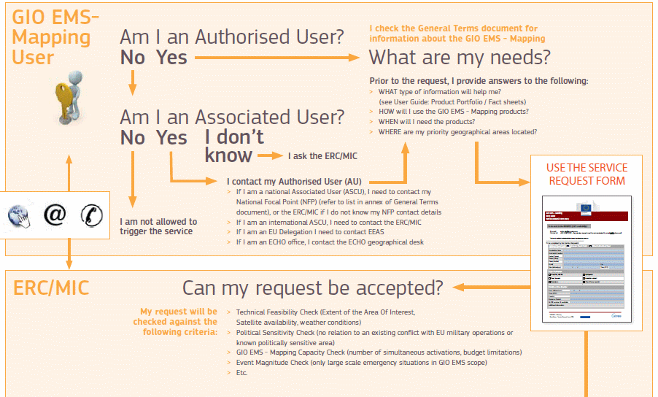
How it works: Decision Scheme

Slide 6
How it work: Level of Urgency

